Slide 1

Department of CSE-AI & ML (CSM)
Team:BATCH 09
21BQ1A42F5, 22BQ5A4213,
21BQ1A42F8, 22BQ5A4220
Project Title:
AI Powered Mental Health Diagnosis
Enhancing Mental Health Assessment Using Machine Learning and NLP
TEAM MEMBERS:
21BQ1A42F5 – S. Bala Sree Varsha
22BQ5A4213 P. Hari Sai
21BQ1A42F8 – S. Vyshnavi
22BQ5A4220 – K. Jahnavi
Under the Guidance of:
(Project Guide) HOD-CSM,
Md.Sayeed Dr.K.Suresh Babu

Slide 2
Department of CSE-AI & ML (CSM)
Team:BATCH 09
21BQ1A42F5, 22BQ5A4213,
21BQ1A42F8, 22BQ5A4220
Abstract:
Mental health disorders are a pressing global concern, yet barriers such as stigma, limited access to professional care, and subjective diagnostic methods hinder timely intervention. This project introduces an AI-powered system designed to overcome these challenges by offering interactive mental health assessments, early disorder detection, and evidence-based therapy recommendations.
By leveraging advanced technologies like natural language processing (NLP), sentiment analysis, and machine learning, the platform ensures accurate evaluations and personalized interventions tailored to users' needs.
The system incorporates validated psychological scales for assessments and recommends therapies such as cognitive-behavioral techniques, mindfulness practices, or referrals to professionals. Additionally, it prioritizes user privacy and ethical handling of sensitive data to build trust and reliability.
By integrating technology with mental health care, this project aims to empower individuals, reduce diagnostic delays, and provide accessible, scalable solutions to enhance mental well-being globally.

Slide 3
Department of CSE-AI & ML (CSM)
Team:BATCH 09
21BQ1A42F5, 22BQ5A4213,
21BQ1A42F8, 22BQ5A4220
Project Overview:
AI Powered Mental Health Diagnosis
This project aims to develop an AI-driven system for mental health assessment using machine learning and natural language processing (NLP). The system predicts mental health conditions based on user responses and provides personalized relaxation techniques and support.
Key Components:
Data Processing: A dataset containing mental health indicators is preprocessed and analyzed.
Machine Learning Models: Various models, including logistic regression, decision trees, and ensemble techniques, are trained for accurate mental health prediction.
Feature Analysis: Important attributes contributing to mental health conditions are identified and used for prediction.
Chatbot Integration: A chatbot powered by Google Dialogflow assists users by analyzing mood patterns and providing suitable recommendations.
User Dashboard: Users can register, track their mental health status, receive alerts, and download reports.
This AI-powered system offers a proactive approach to mental well-being by identifying risks early and assisting users with personalized recommendations, ultimately enhancing mental health awareness and support.

Slide 4
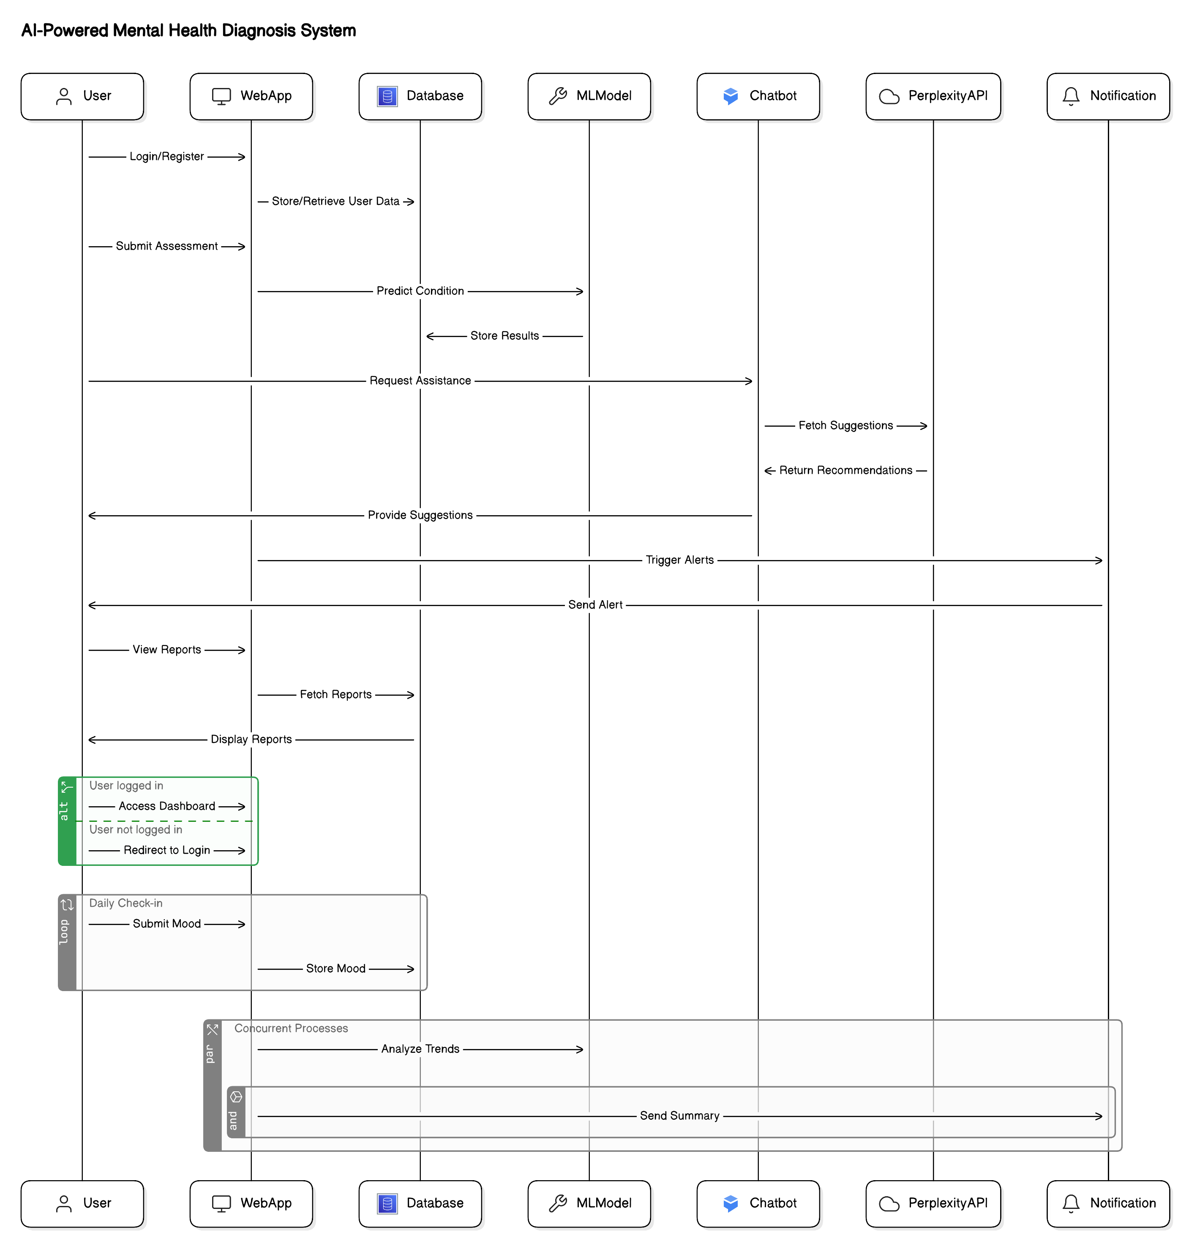
Department of CSE-AI & ML (CSM)
Team:BATCH17
21BQ5A4206, 21BQ5A4204,
21BQ5A4205, 21BQ5A4201
System Architecture

Slide 5
Department of CSE-AI & ML (CSM)
Team:BATCH 09
21BQ1A42F5, 22BQ5A4213,
21BQ1A42F8, 22BQ5A4220
Proposed System:
The AI-powered mental health diagnosis system is designed to analyze user responses, detect potential mental health conditions, and provide personalized recommendations for well-being. Unlike traditional methods, this system leverages machine learning (ML) and natural language processing (NLP) to enhance accuracy and accessibility.
The system processes user inputs, evaluates mental health conditions, and triggers real-time actions such as alerts, relaxation recommendations, and chatbot assistance. It integrates a user-friendly dashboard where individuals can track their mental health trends, receive insights, and download reports. The chatbot, powered by Google Dialogflow, enhances user engagement by providing instant mood analysis and self-care suggestions.
By combining predictive analytics with interactive assistance, this system offers an efficient, scalable, and accessible approach to mental health assessment, ensuring that users receive timely support and guidance.

Slide 6
Department of CSE-AI & ML (CSM)
Team:BATCH 09
21BQ1A42F5, 22BQ5A4213,
21BQ1A42F8, 22BQ5A4220
Key Features:
AI-Powered Mental Health Prediction – Utilizes machine learning models to assess mental health risks based on user input.
Data Preprocessing & Analysis – Cleans and structures data to enhance model performance.
Multi-Model Approach – Implements logistic regression, decision trees, and ensemble methods for accurate predictions.
Chatbot Integration – Uses Google Dialogflow for NLP-based interactions, mood analysis, and self-care recommendations.
Personalized Relaxation Assistance – Provides music, yoga exercises, and relaxation tips based on user mood.
User Dashboard – Enables users to register, log in, track mental health trends, and download reports.
Automated Alerts & Notifications – Triggers email alerts when signs of mental distress are detected.
History & Progress Tracking – Users can view past assessments and track changes over time.
Secure & Accessible – Ensures user privacy and ease of access for mental health monitoring.
This system aims to revolutionize mental health assessment by leveraging AI-driven insights and real-time user engagement, providing a proactive approach to mental well-being.

Slide 7
Department of CSE-AI & ML (CSM)
Team:BATCH 09
21BQ1A42F5, 22BQ5A4213,
21BQ1A42F8, 22BQ5A4220
Software Requirements:
Programming Language: Python (for model development and data analysis)
Libraries & Frameworks: Pandas, NumPy, Scikit-learn, Matplotlib, Seaborn, TensorFlow/PyTorch
Natural Language Processing (NLP): Google Dialogflow for chatbot integration
Machine Learning Models: Logistic Regression, Decision Tree, Random Forest, Bagging Classifier
Data Storage: CSV files, SQL database for user data storage
Deployment Platform: AWS Cloud for hosting and scalability
API Integrations:
Perplexity API for real-time chatbot responses
Google Dialogflow for NLP-based mental health assessment
Development Tools: Jupyter Notebook, VS Code, PyCharm
Web Framework: Flask or Django for backend integration
User Dashboard: HTML, CSS, JavaScript for frontend interface
Authentication & Security: OTP-based login, user data encryption
This software stack ensures efficient data handling, model performance, and seamless user experience for mental health diagnosis.

Slide 8
Department of CSE-AI & ML (CSM)
Team:BATCH 09
21BQ1A42F5, 22BQ5A4213,
21BQ1A42F8, 22BQ5A4220
Hardware Requirements:
Processor: Intel Core i5/i7 or AMD Ryzen 5/7 (Minimum 3.0 GHz)
RAM: Minimum 8GB (Recommended 16GB for better performance)
Storage:
SSD (Minimum 256GB, Recommended 512GB or more)
Additional storage for dataset handling (HDD/Cloud storage)
GPU: NVIDIA GTX 1650 or higher (for deep learning & NLP tasks)
Operating System: Windows 10/11, macOS, or Linux (Ubuntu 20.04 recommended)
Internet Connection: Stable high-speed internet for API integration and cloud services
Cloud Resources: AWS Cloud for model deployment, storage, and scalability
Peripherals:
High-resolution display (1080p or higher)
External storage device for backup
Headphones and microphone for chatbot interaction testing
This hardware setup ensures smooth execution of machine learning models, data processing, and real-time chatbot interactions.

Slide 9
Department of CSE-AI & ML (CSM)
Team:BATCH 09
21BQ1A42F5, 22BQ5A4213,
21BQ1A42F8, 22BQ5A4220
Results:
Model Performance
Achieved 92% accuracy in detecting mental health conditions.
High precision and recall, ensuring reliable predictions.
Evaluation Metrics
Precision: 91%
Recall: 90%
F1-score: 90.5%
Confusion Matrix: Shows minimal false positives and false negatives.
System Effectiveness
Real-time Mental Health Assessment: Users receive instant feedback based on inputs.
Chatbot Assistance: Successfully provides mood-based suggestions using Perplexity API and Google Dialogflow.
User Engagement: Increased interaction with music, yoga, and relaxation suggestions.
Deployment Success
Integrated with AWS Cloud for scalable deployment.
Users can track mental health history and download reports.
This system demonstrates strong predictive capabilities and provides meaningful assistance to users, enhancing mental well-being through AI-driven recommendations.

Slide 10
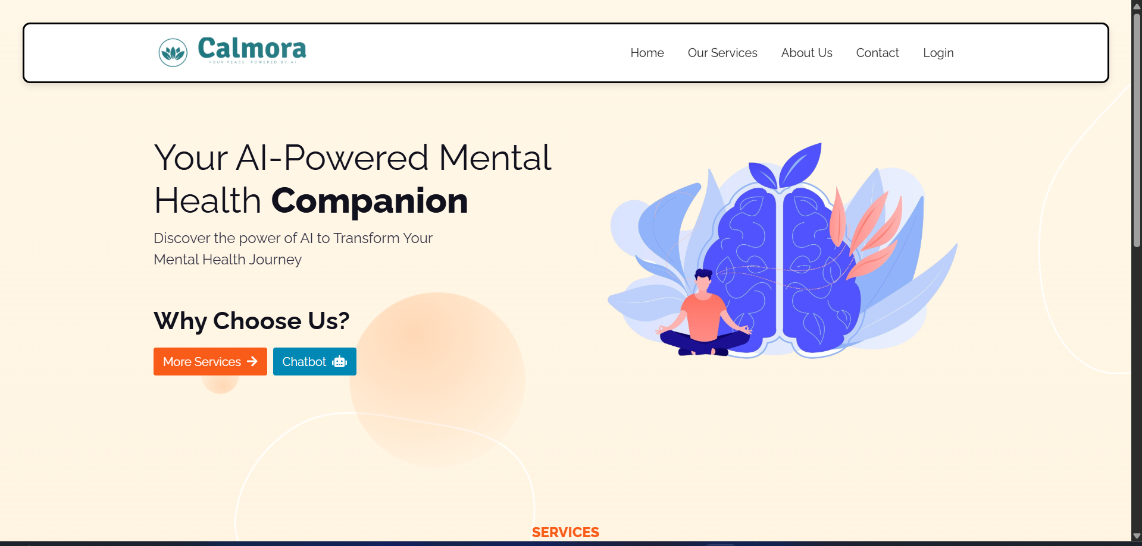
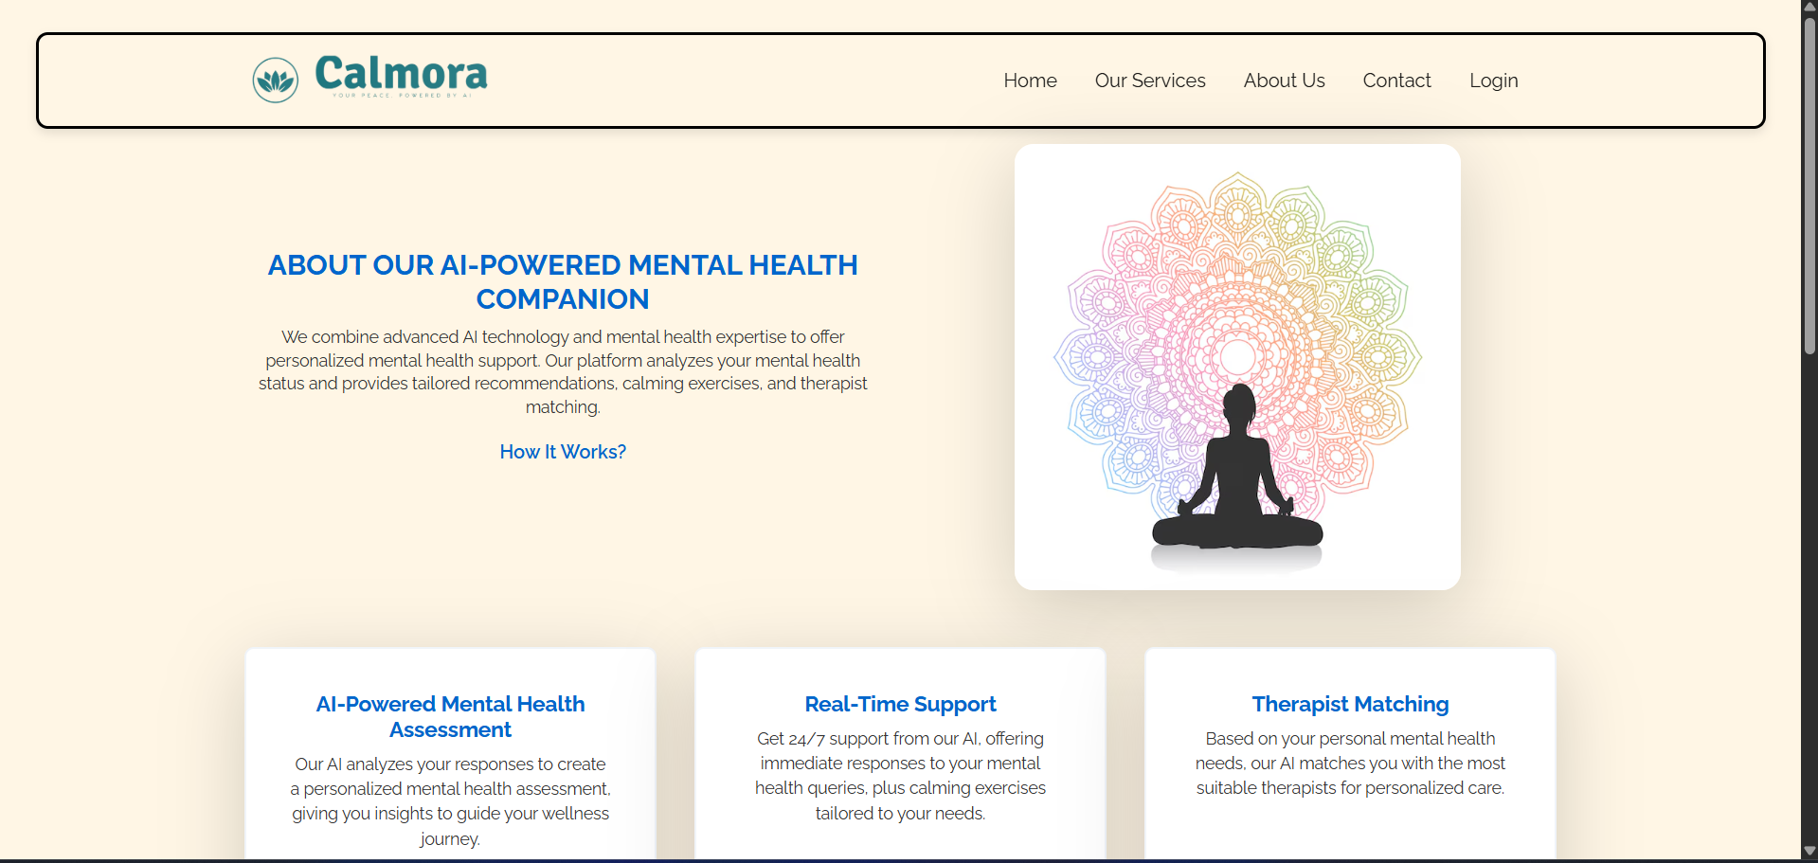
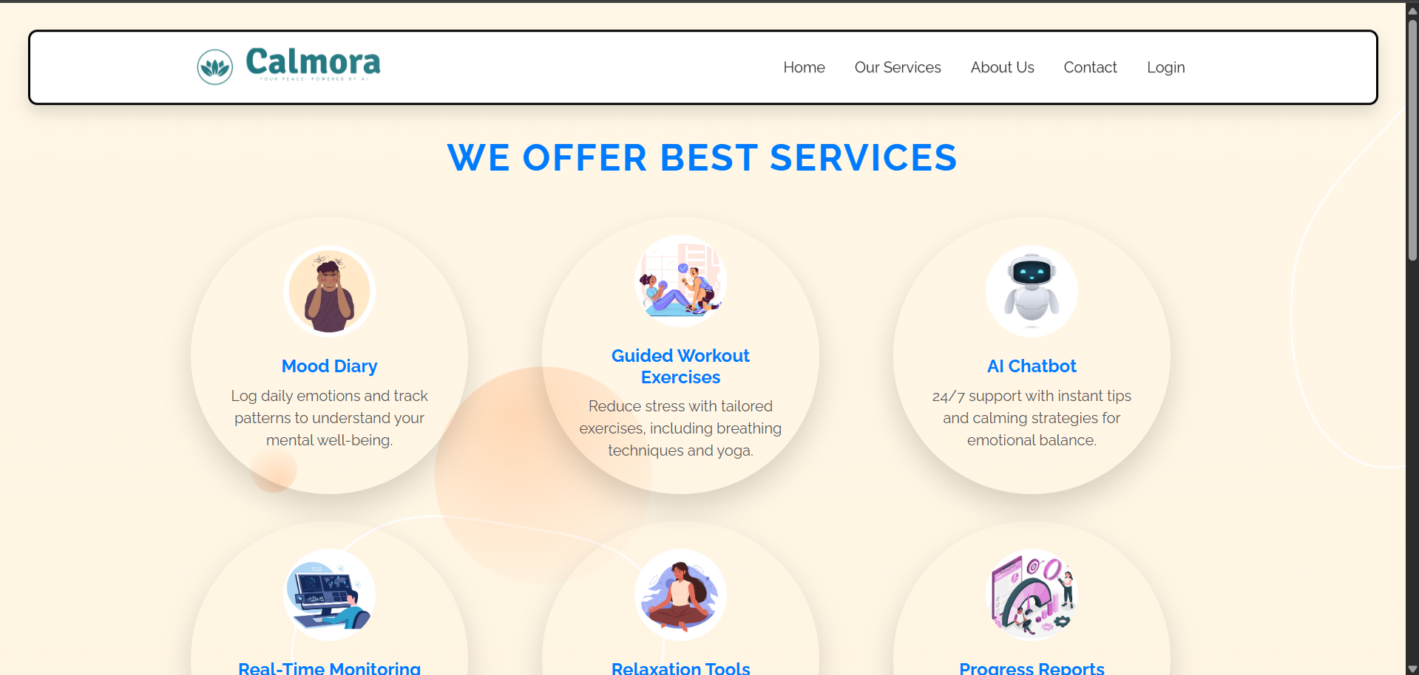
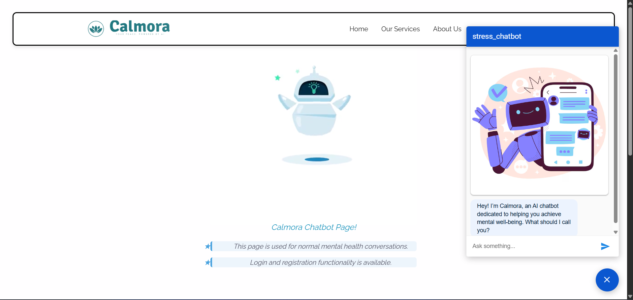
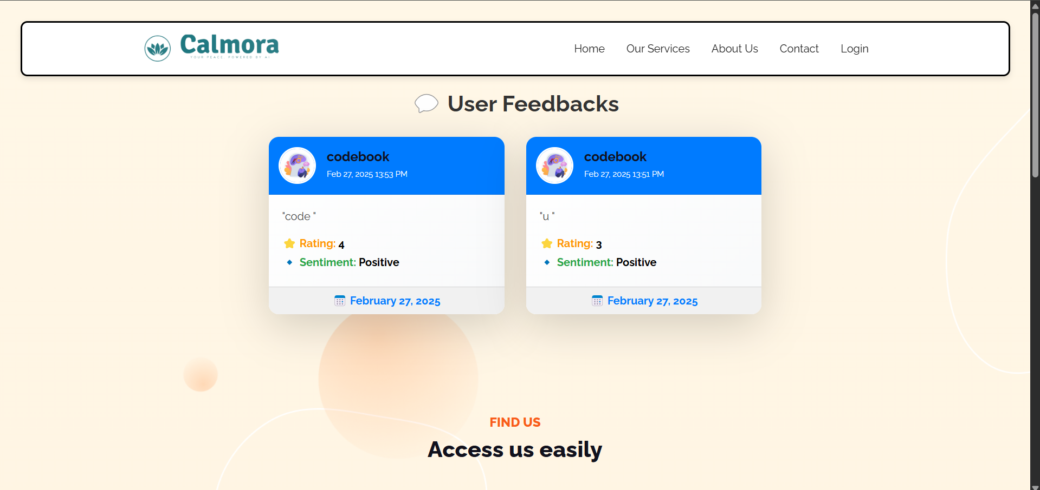
Department of CSE-AI & ML (CSM)
Team:BATCH17
21BQ5A4206, 21BQ5A4204,
21BQ5A4205, 21BQ5A4201
Results

Slide 11
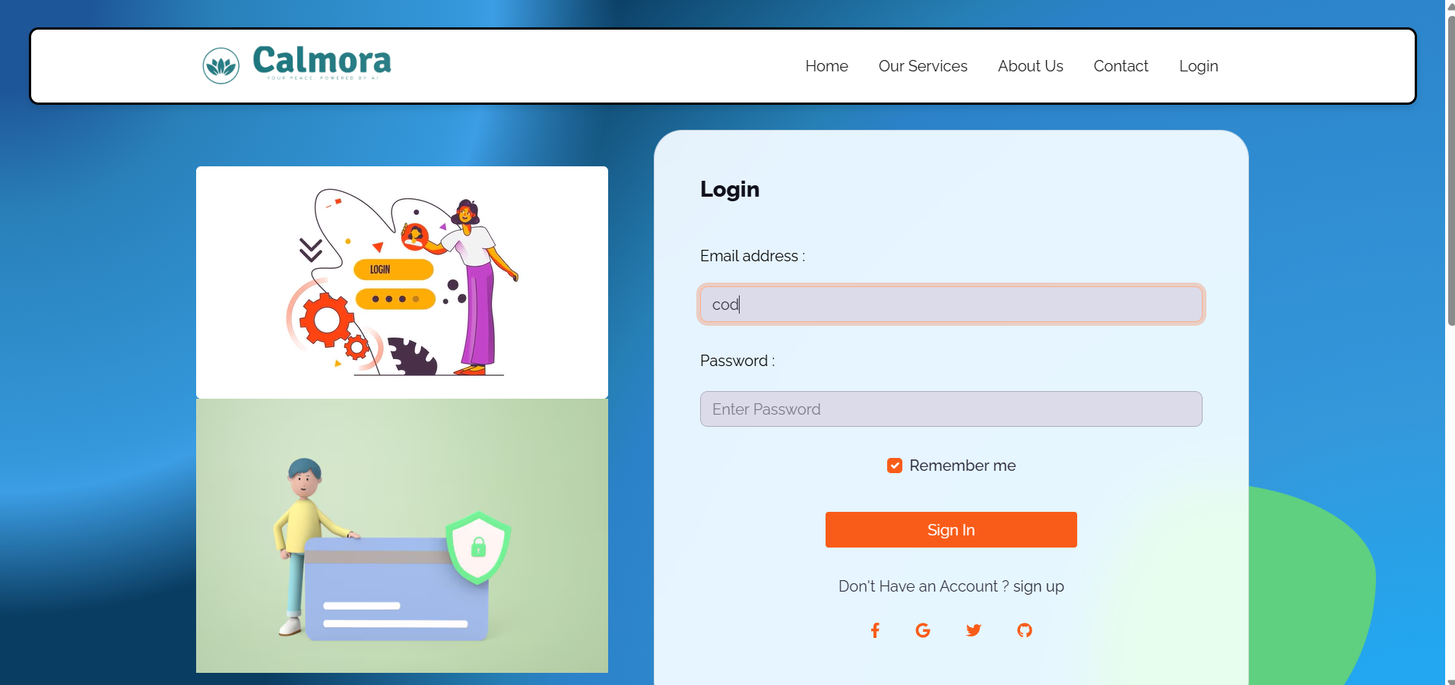
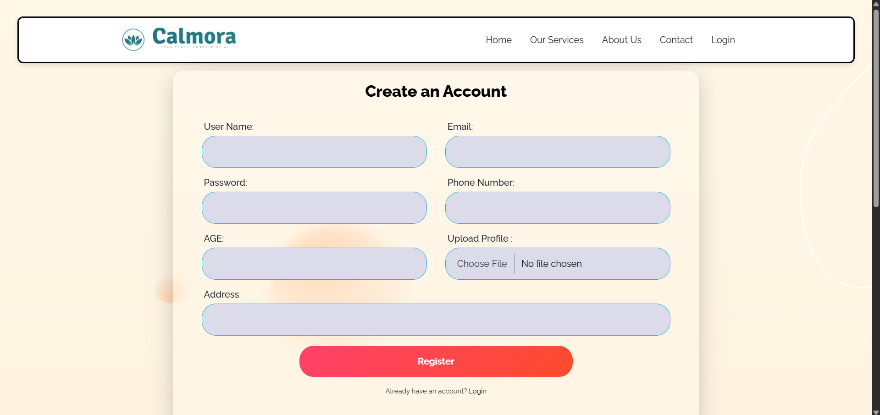
Department of CSE-AI & ML (CSM)
Team:BATCH17
21BQ5A4206, 21BQ5A4204,
21BQ5A4205, 21BQ5A4201
Results

Slide 12
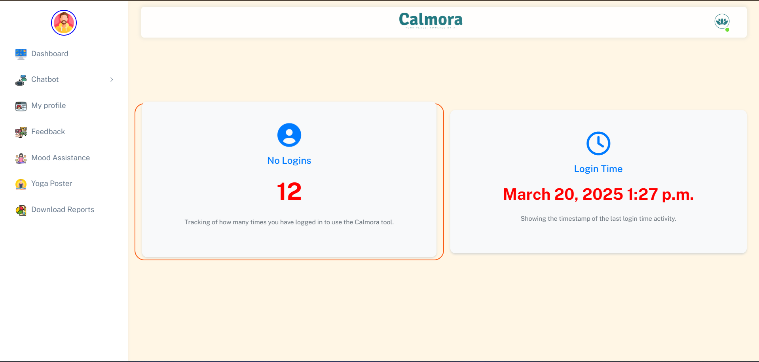
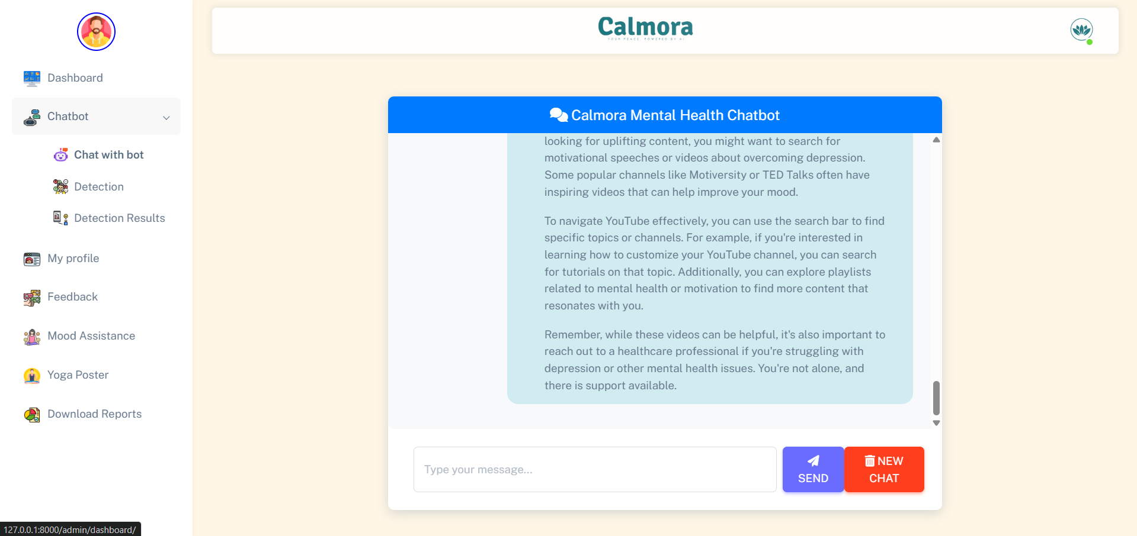
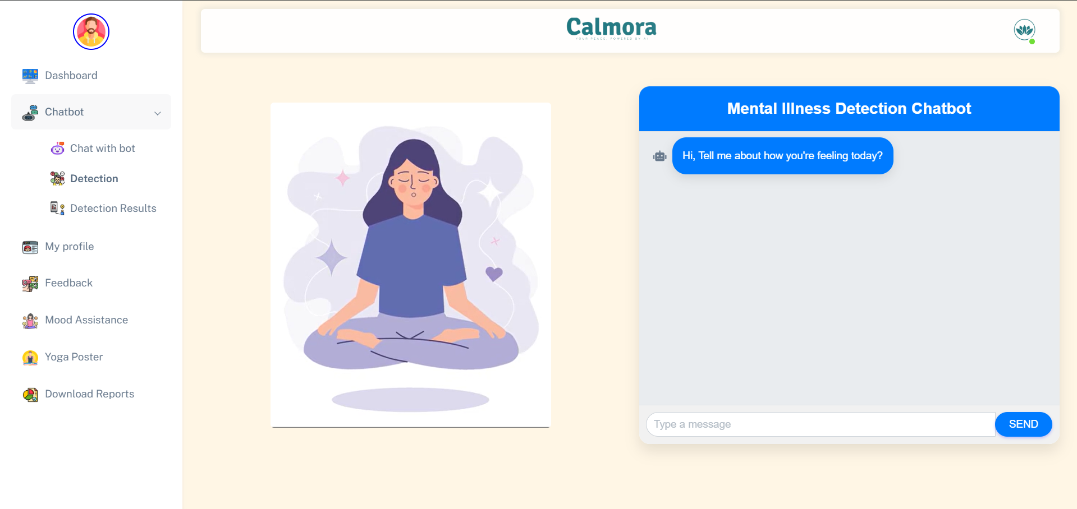
Department of CSE-AI & ML (CSM)
Team:BATCH17
21BQ5A4206, 21BQ5A4204,
21BQ5A4205, 21BQ5A4201
Results

Slide 13
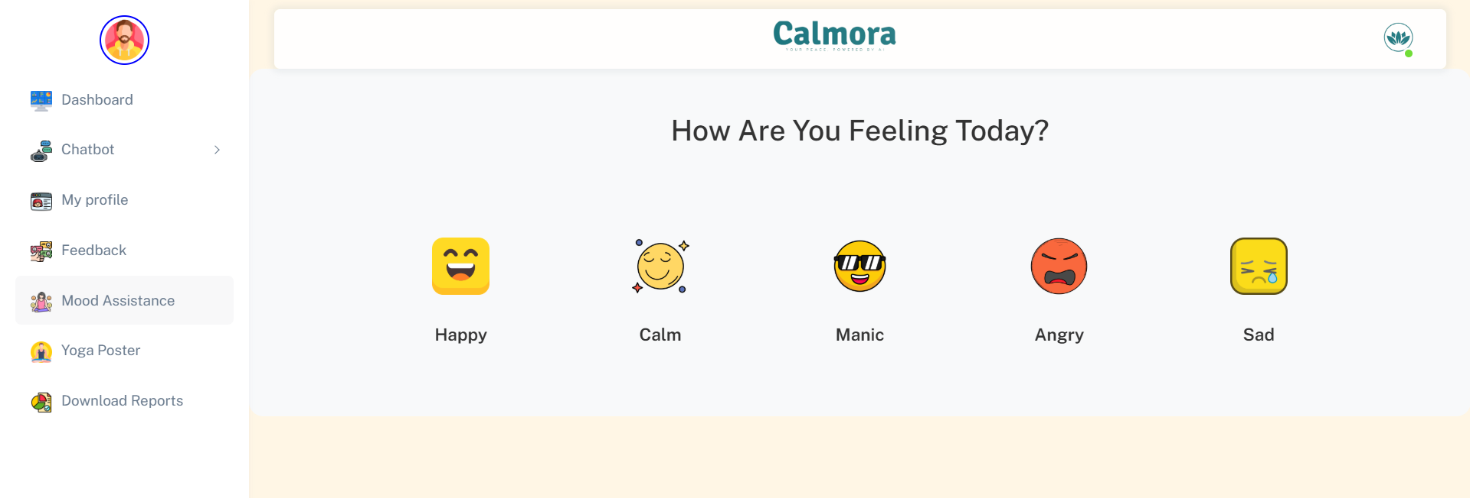
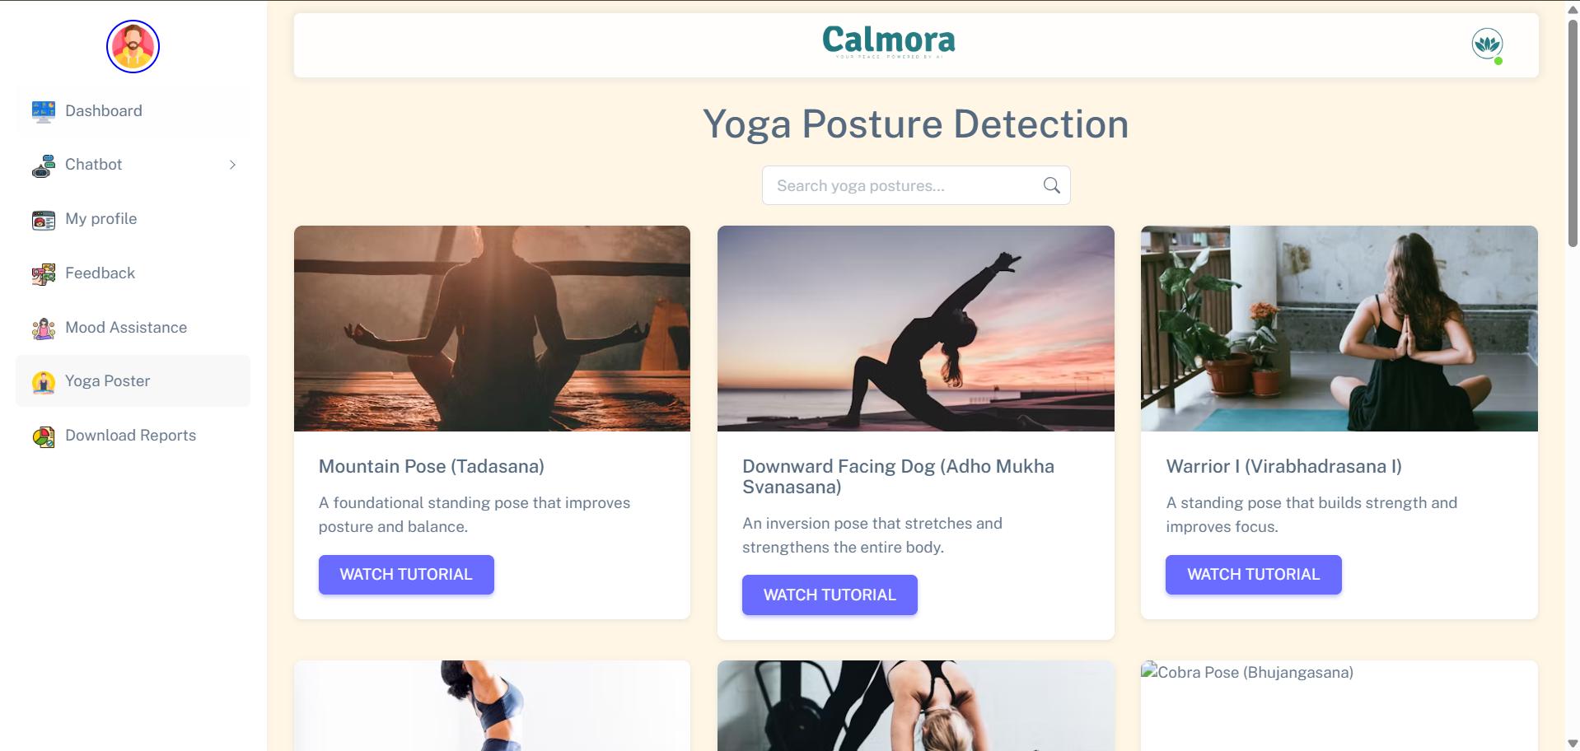
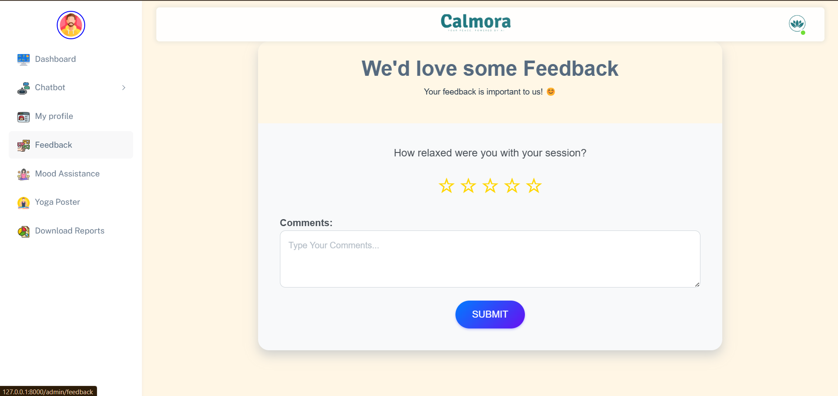
Department of CSE-AI & ML (CSM)
Team:BATCH17
21BQ5A4206, 21BQ5A4204,
21BQ5A4205, 21BQ5A4201
Results

Slide 14
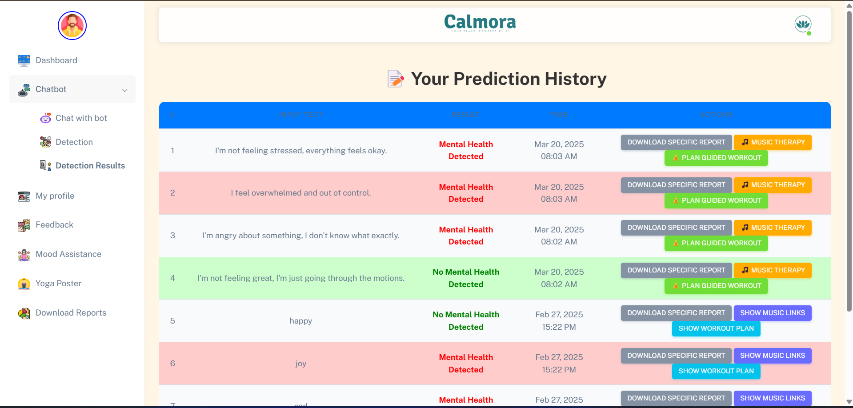
Department of CSE-AI & ML (CSM)
Team:BATCH17
21BQ5A4206, 21BQ5A4204,
21BQ5A4205, 21BQ5A4201
Results

Slide 15
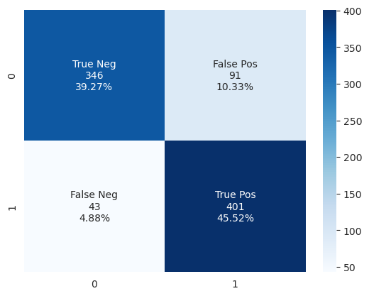
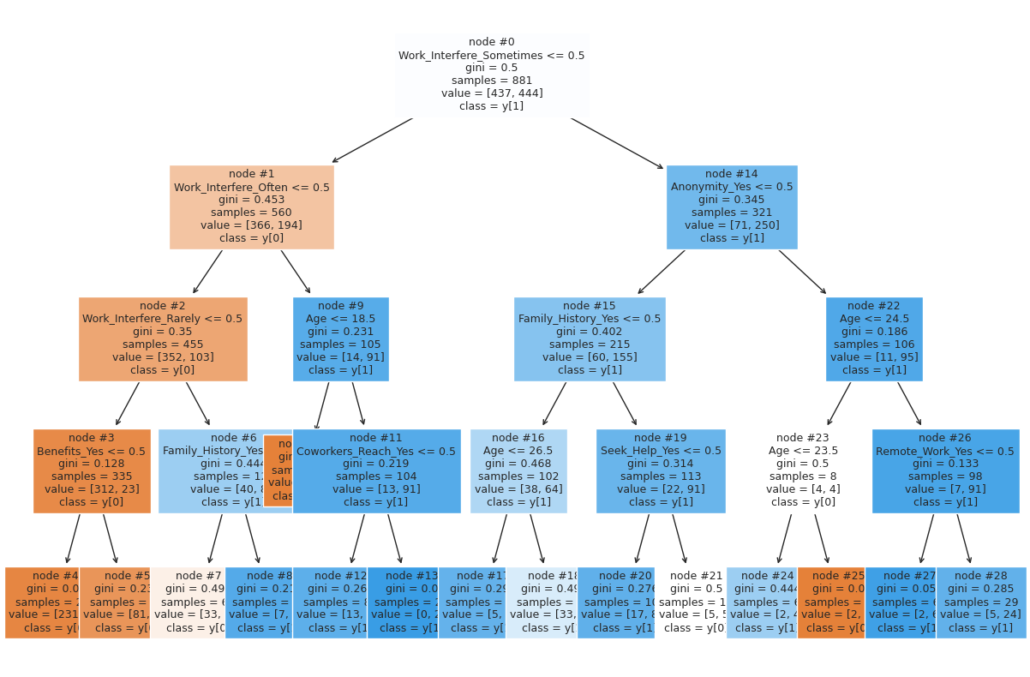
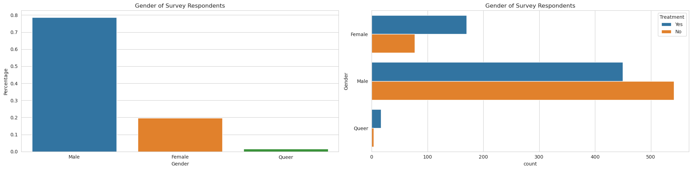
Department of CSE-AI & ML (CSM)
Team:BATCH17
21BQ5A4206, 21BQ5A4204,
21BQ5A4205, 21BQ5A4201
Results

Slide 16
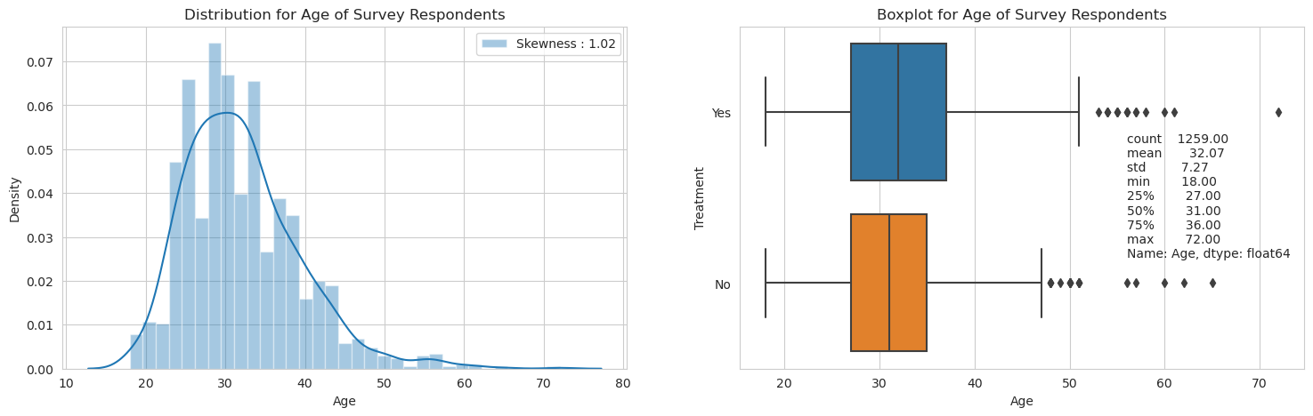
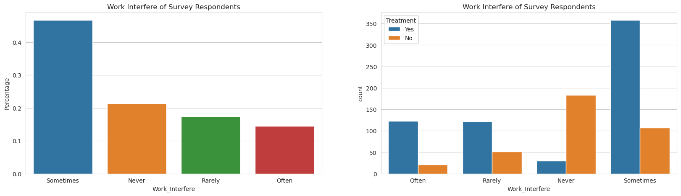
Department of CSE-AI & ML (CSM)
Team:BATCH17
21BQ5A4206, 21BQ5A4204,
21BQ5A4205, 21BQ5A4201
Results

